Slide 1
Software Product Design and Development I
Dr. John Businge
John.businge@unlv.edu
TA: Daniel Ogenrwot
ogenrwot@unlv.nevada.edu
Notes:
Good afternoon dear All
Welcome to the class Software Product Design and Development I.
My name is Dr. John Businge and the professor responsible for this class. I am so exited to be taking you in this class
Attendance is not compulsory. However, it would be nice if you attend you can influence what we are going to discuss and how we are going to discuss it
This class will be physical

Slide 2
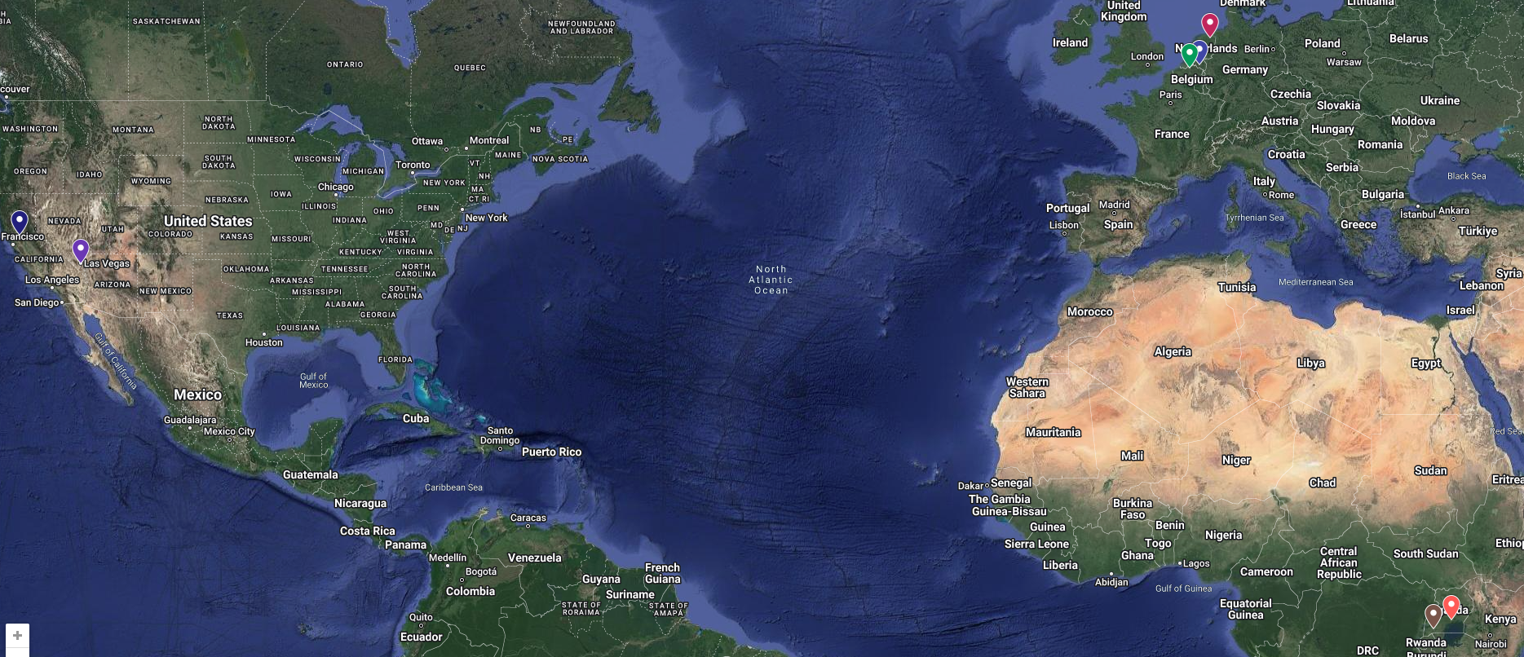
My Journey to UNLV
Notes:
First let me give you a brief about myself

Slide 3
Administration
Background Information survey.
Go to - https://johnxu21.github.io/teaching/CS472/
Notes:
Let us discuss the boreing stuff about administation.

Slide 4
CSC 472/672 AND OTHER COURSES
Prerequisites:
CS 326 - Programming Languages, Concepts and Implementation
CS 370 - Operating Systems

Slide 5

4
th
Notes:
This is the 4th time I am teaching this course.
What this means is that I am still a student of this class and learning to improve in my mistakes.
But at the same time, it is a great opportunity for you to influence how this course is going to look like.
In case you have feedback, please do not wait until the end of the course; Kindy give me the feedback as we go on. If it means giving it to me privately/anonymously, I will be more than happy to receive feedback
This is all I had for the administration. Before I can continue, are there any questions?

Slide 6

Software Product Design and Development I
High Quality Software
Flexible
Reusable
Maintainable
Collaboratively
Notes:
The class we are going to study is “Software Product Design and Development I”
We shall learn how to collaboratively develop software of high quality that is flexible, reusuable and maintainable

Slide 7
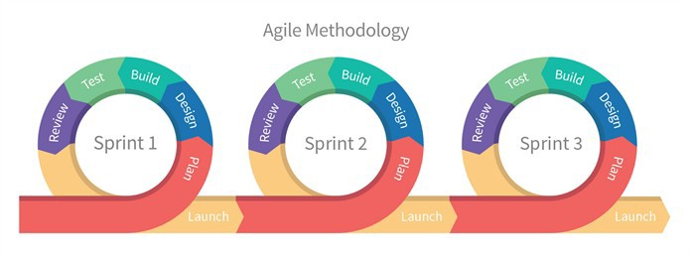
Design Portfolio I
Design Portfolio II
Design Portfolio III
Agile methodology: Development delivers frequent, small software updates, enabling teams to quickly adapt to changes and continuously improving the product based on feedback.

Slide 8
Minimum Viable product (MVP)
During the DP we will focus on developing an MVP
An MVP is the minimal thing that you can do to test a value hypothesis and gain learning and understanding
MVP is focus on learning, not delivery
Let us explain an MVP with an example using Agile developmemnt
Notes:
During the DP we will focus on developing a MVP
You can finish the first MVP, then get the results and move to the second one, and so on.
The difference between these two is that the first one is all about delivery.
What am I going to deliver?
But the second one is all about learning.
What can I learn?
What can I learn from putting out this MVP and getting feedback and then maybe making
the next one even better?
So, it's important that at the end of each MVP you decide whether to pivot or persevere.
Should I pivot, that is, do something different or persevere, that is, continue doing what
I’m doing?

Slide 9
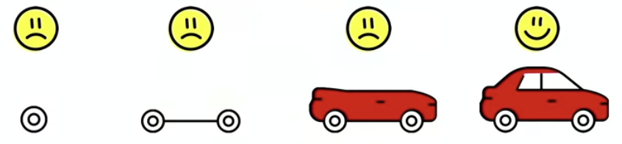
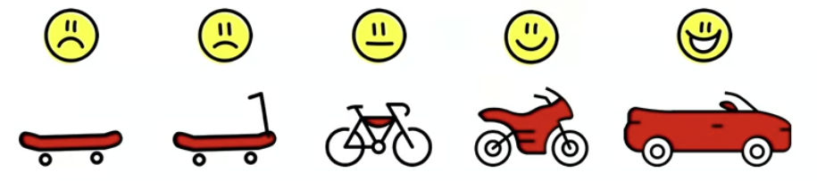
Minimum Viable product (MVP)
Customer wants a red car
Iteration 1
Iteration 2
Iteration 3
Iteration 4
Customer got exactly what they asked for
the dev team was just following a plan.
Team does not understand the value of MVP
Agile dev 1
No feedback
Customer got what they desired
Worked iteratively with the dev team.
developed something a little bit different but it's closer to what the customer really wanted.
Giving the customer what they really want is the main purpose of delivering an MVP.
A minimal viable product is a tool for learning.
Agile Dev 2
Valuable feedback on every iteration
Notes:
Let's look at an example.
Here's a team that's developing a minimum viable product for a customer that wants a red car.
And so, in the first iteration, they deliver a wheel. The customer's like, "What am I going to do with a wheel? I can't do anything with this."
Well, we’re working on iterations they say, we're trying to be agile here. In the next iteration, we'll give you something more.
And they give the customer a chassis. And the customer responds, "I still can't do anything with this chassis."
And then, they give them a car with no steering wheel and then eventually they get the whole car. Now the customer gets this car.
There was no feedback along the way. The team didn't know until the end whether the customer was going to like what they built or not.
The team did not understand how to create a minimum viable product. They were just doing iterative development with no regard to whether each increment was useful or not.
The second team understands the value of creating an MVP.
At first, they give the customer a skateboard and the customer says, "What's this? I asked you for a car and you're giving me a skateboard."
The team explains, we're testing the color. How do you like that color red? Is that the color you want?
The customer says, "Oh yeah, red's kind of cool but you know it's really hard to steer."
The team says, “No worries.”
In the next MVP, they give him a way to steer it.
The customer says, "Well, okay, you did give me a way to steer it but I can't go very fast. I need a better form of locomotion."
The team deals with that in the next MVP. In the next iteration, they give them pedals to go faster.
Somewhere along the way, while riding on that motorcycle feeling the wind in their hair the customer decides, "I really want a convertible!"
In the first instance, the customer got exactly what they asked for months prior because the
development team was just following a plan.
But in the second instance, the customer got exactly what they desired because they were
working iteratively and interactively with the development team.
In the end, you develop something that's a little bit different but it's closer to what
the customer really wants.
Giving the customer what they really want is the main purpose of delivering an MVP.
A minimal viable product is a tool for learning.
It is an experiment to explore the value proposition with your customer.

Slide 10
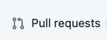
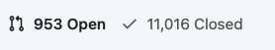
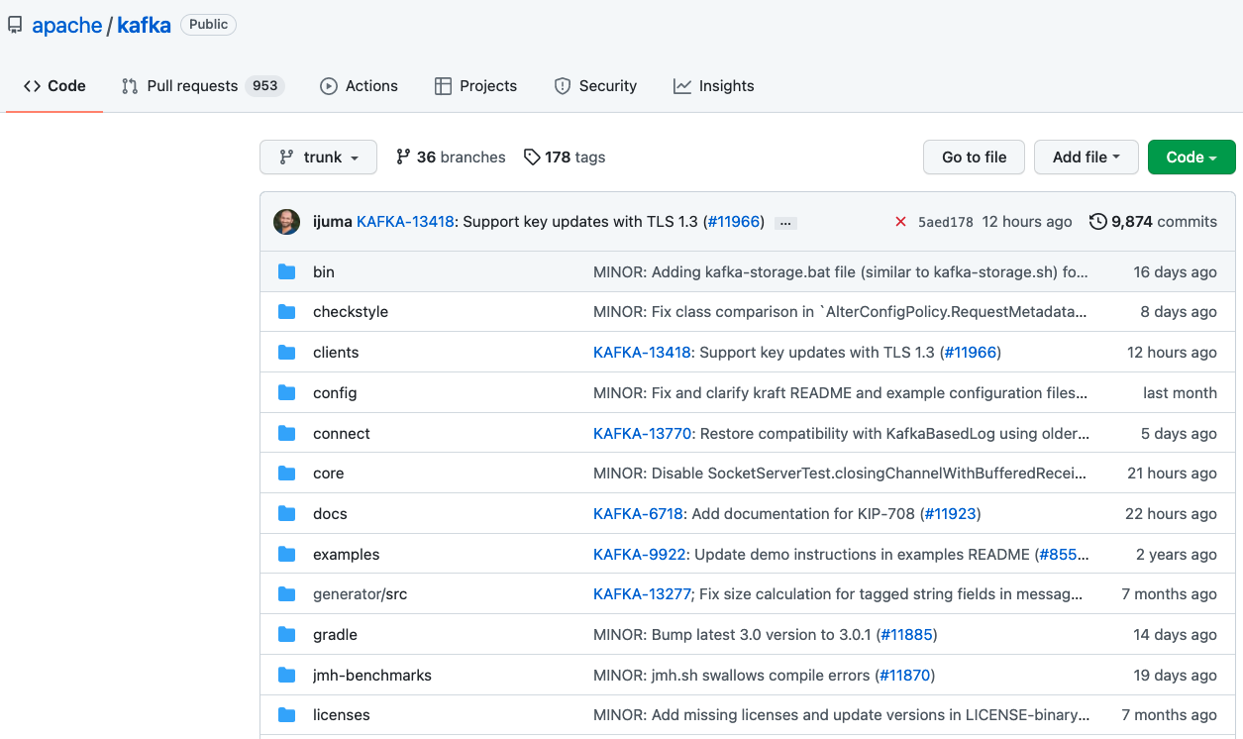
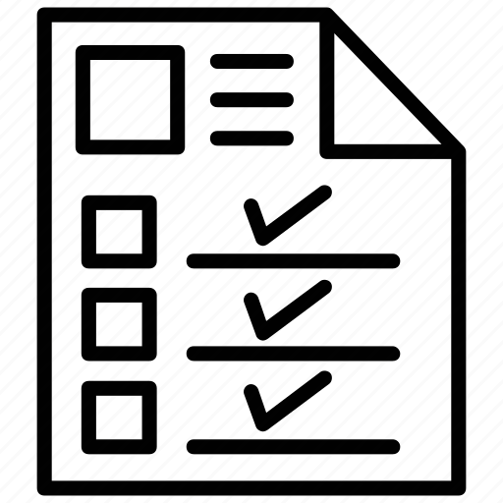
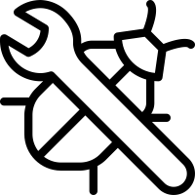
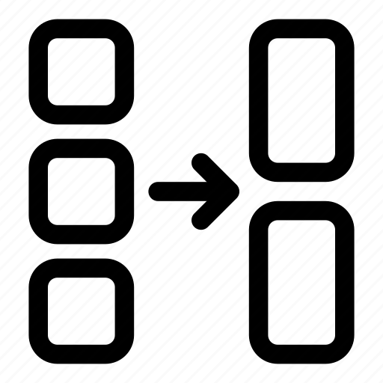

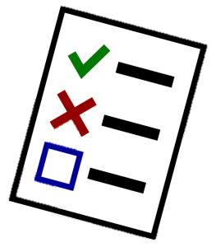

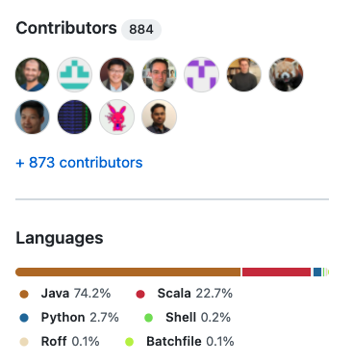
1.7k
Apache Kafka is a distributed event store and stream-processing platform
10
Notes:
We shall follow standards used in industry.

Slide 11
“People-related factors tend to be the greatest challenges—not technology.”
George Spafford,
Senior Director Analyst
at Gartner
Notes:
In the previous slide you can see that there are a lot of developers involved.

Slide 12
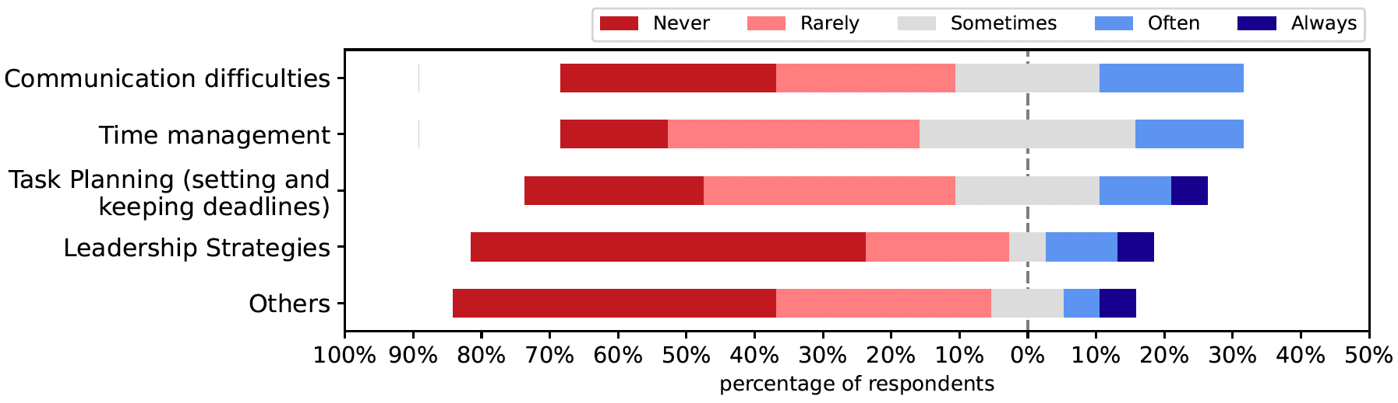


Survey Results – Team Challenges
Qn.6: Please rank the following challenges that could have impeded effective teamwork.
Qn.7: If your ranking for "Others" in Qn.6 above was 4 or 5, kindly provide us what it represents.
[R2]. Others -- People simply not doing work. We only had about half of our group contribute anything meaningful to the project. The half of the group that were not participating made it hard for the group to progress collaboratively.
Notes:
A month after the Spring class 472, I conducted a survey with the students.
One of the aims of the survey was to learn from the students how they managed to cope up with team challeges.

Slide 13
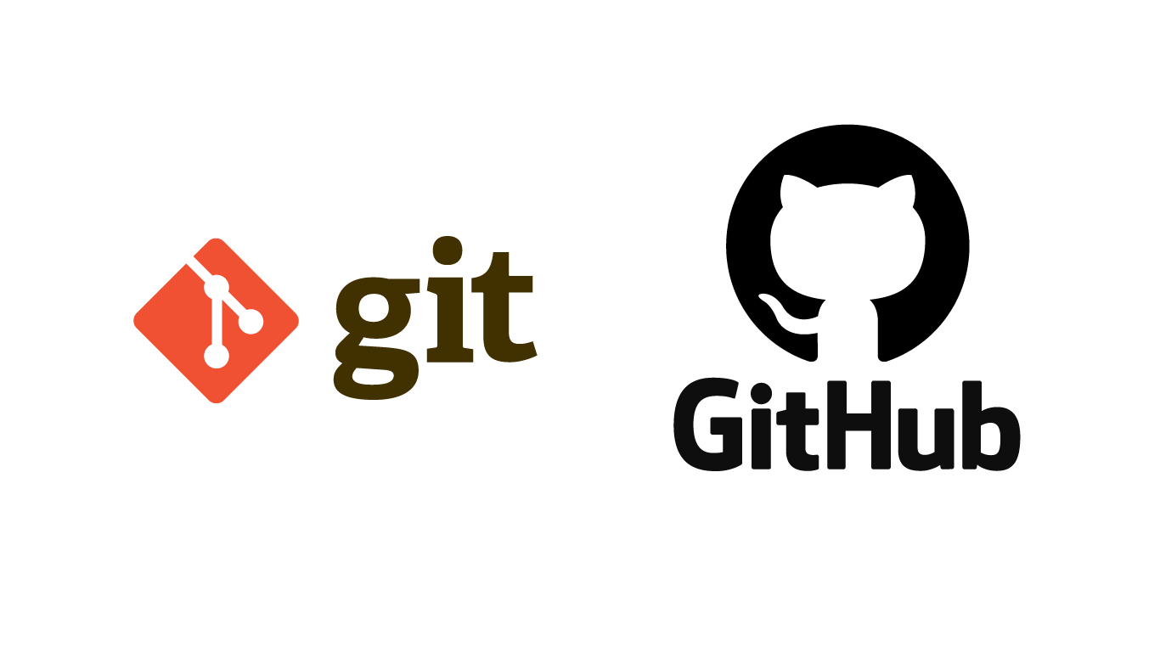
What is social coding?
Open source practice - Open Source for Inner Source
All repositories are public
Everyone is encouraged to contribute
Contribute back via Pull Requests
Notes:
With social coding, repositories are public, and everyone is encouraged to fork the code and contribute.
Git is a version control system
GitHub is a webhosting for Git

Slide 14
What problem is social coding solving?
A component has 80% code of what you need, but 20% is missing features.
How do you add the 20% missing features?
You have a decision to make:
Do you make a feature request and depend on another team?
Do you rebuild 100% of what you need (no dependencies)
This is a huge waste of resources for any company, but it happens all the time.
How does adopting social coding principles solve this?
Many teams select
Notes:
Let's say, you see a component, it’s 80% of what you need, but there are some missing
features.
How do you add those missing features?
You now have a decision to make:
Do you make a feature request to the repo owner for a new feature and risk that your
request will be at the bottom of their priority list?
Or worse, their funding gets cut, and your request will be cut out first.
Or do you rebuild 100% of the code just to get the 20% that you need so as not to have
a dependency on another team?
It’s sad to report, but many teams select the latter and re-invent the entire wheel
just to get the functionality they need.
This is a huge waste of resources for any company, but it happens all the time.
How does adopting social coding principles solve this?

Slide 15
Social coding solution
Discuss with the repo owner
Agree to develop it
Open an issue and assign it to yourself
Fork the code and make your changes
Issue a Pull Request to review and merge back
This is how open source works and how we shall approach this team project
Notes:
You discuss the new feature with the repo owner, and you agree to develop it for them.
This allows you to leverage everything that they've done and add the feature that you need.
You open up a GitHub Issue and you assign it to yourself so that everyone knows you’re working on it.
Then you fork the repo, create a branch, and make your changes

Slide 16
Git-Github repository guidelines
Create a repository for a project
Create a new branch for every issue
Use a Pull Requests to merge to mainline
Every Pull Request is an opportunity for code review
Git Feature branch workflow

Slide 17
Git-Github feature branch workflow
Pull Request
Merge
GitHub Repo
Remote Branch
Clone
Push
Local Repo
Feature Branch
Local Branch
We will employ the git feature branch workflow in our team project
Notes:
Finally, you create a pull request to request that your changes be reviewed.
The pull request will be reviewed and if the code is complete and meets the standards
set out by the team, it will be merged back into the master branch and become
part of the original GitHub repository.

Slide 18
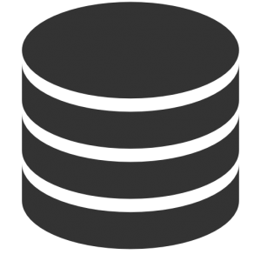







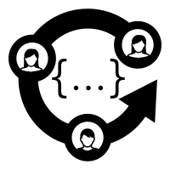
A simple Code Review Workflow
Merge PR
Requirements
PL coding style Guide
The code has passed all tests (CI)
Test Coverage (>95)
Code is well Documented
PR Address all requirements
Main repo
PR misses some requirements
Evaluate
Code Reviews
Fork repo
Clone
PR
Main repo Maintainers
Push changes
Developer
Fork Remote branch
Assign reviewers
submit PR
Pull request
Reviewers

Slide 19
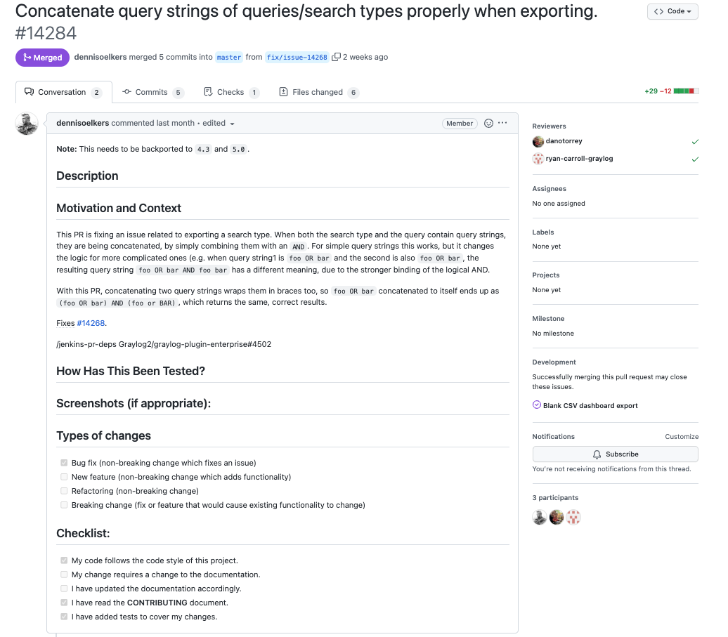
Best Practices Pull Requests Documentation
https://github.com/Graylog2/graylog2-server/pull/14284

Slide 20



Issue Tracker - GitHub
Issues
Use cases
Bugs to fix
Features to add
Documentation to add
Software Project
Notes:
issue tracker or bug tracker can help us coordinate our work better. An issue tracker tells us the tasks that need to be done, the state they're in and who's working on them.
The system also let's us add comments to the issue, these comments can be super helpful. They can give us more details about the problem, explain a way to solve it, or detail how to test if it's been solved. Issue trackers aren't just useful for people actively working on projects.
Having a clear visible list of the pending work, lets new contributors figure out how to help and where to jump in.
So, if you're hosting your project there, it can be very handy to track work on your project. Like the problems to solve, the features to add and the use cases to include it, let's check it out.

Slide 21
Testing
“If it is worth building, it is worth testing.
If it is not worth testing, why are you wasting your time working on it?”
Scott Ambler, agiledata.org

Slide 22
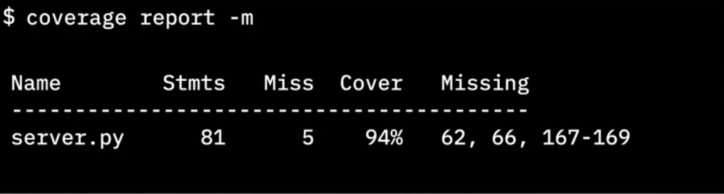
Importance of test coverage
High test coverage gives you confidence that your code works as expected
Test coverage reports can reveal which lines of code were not tested
Python cmd tool
Total lines of code
# lines without test cases
Lines without test cases
Notes:
Finally it gives us the line numbers that did not have test cases.
This info is critical because now we know where to concentrate our tests.
We need to go write more test cases to cause those lines of code to be executed.

Slide 23
Basic TDD workflow
RED
(Fail)
Write test case that fails
Red,
Green,
Refactor
REFACTOR
GREEN
(Pass)
Write code for test case – tests pass
Improve the code quality
I have prepared the lab which will guide you in practicing with TDD
Notes:
In TDD, you first write a test case for the code you wish you had. You don’t start by writing the code. You write the test cases first.
Second, you write the code to make that test case pass.
And then third, you refactor the code to make it more robust, knowing that the test cases will let you know if you change the code’s behaviour.
And finally, refactor that code to make it more robust knowing that the test case will let you know if you change the behaviour of the code.

Slide 24
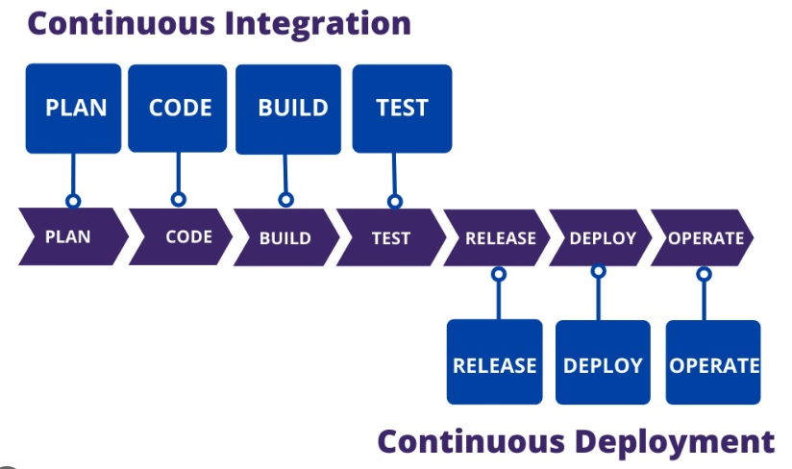
CI/CD pipeline
Continous Integration
Continous Delivery

Slide 25
Using LLMs to perform specific SDLC activities

Slide 26





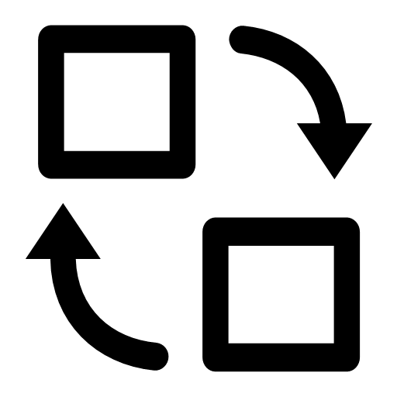
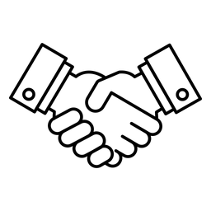


The Hype around LLMs for Software Development
Cooling down
Replace
Partner
Notes:
The initial hype around using LLMs for software development has already started to cool down
The conversation has shifted from expecting LLMs to replace software developers (i.e., artificial intelligence) to considering LLMs as partners and focusing on where to best apply them (i.e., augmented intelligence).

Slide 27
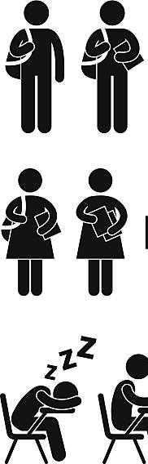
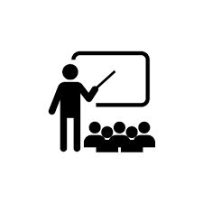


The Hype around LLMs for Software Development
Cooling down
Notes:
The initial hype around using LLMs for software development has already started to cool down
The conversation has shifted from expecting LLMs to replace software developers (i.e., artificial intelligence) to considering LLMs as partners and focusing on where to best apply them (i.e., augmented intelligence).

Slide 28
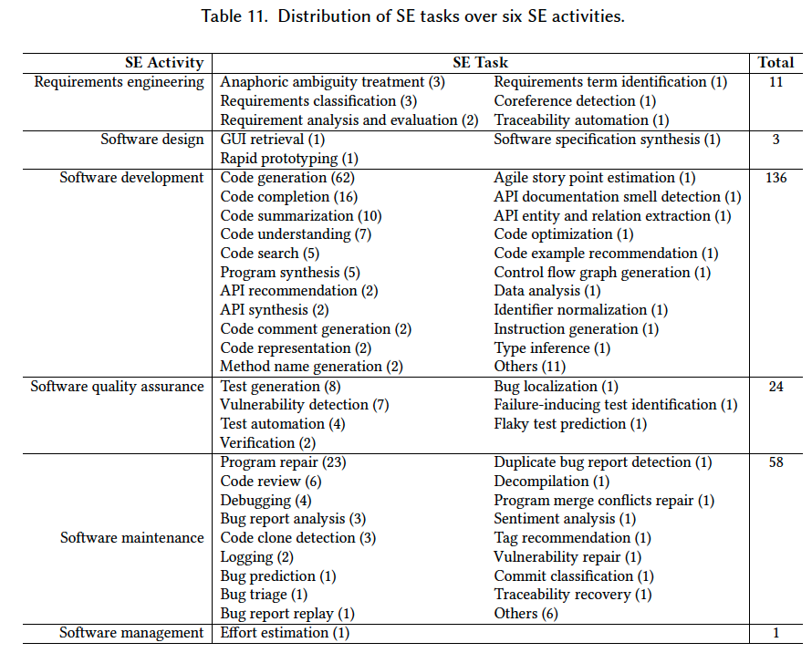
What SE Tasks have been addressed to date using LLM4SE
Hou et al. LLMs for SE: A Systematic Literature Review
https://arxiv.org/pdf/2308.10620.pdf
Analyzed 229 research papers on the subject
Read Section 6 of the paper to find which papers have addressed the SE tasks.
Notes:
Traceability automation. Software and system traceability refers to the ability to establish and maintain relationships between software artifacts, such as requirements, design definitions, code, and test cases, for product querying and development support.

Slide 29

Assessment

Slide 30


